Slide 1
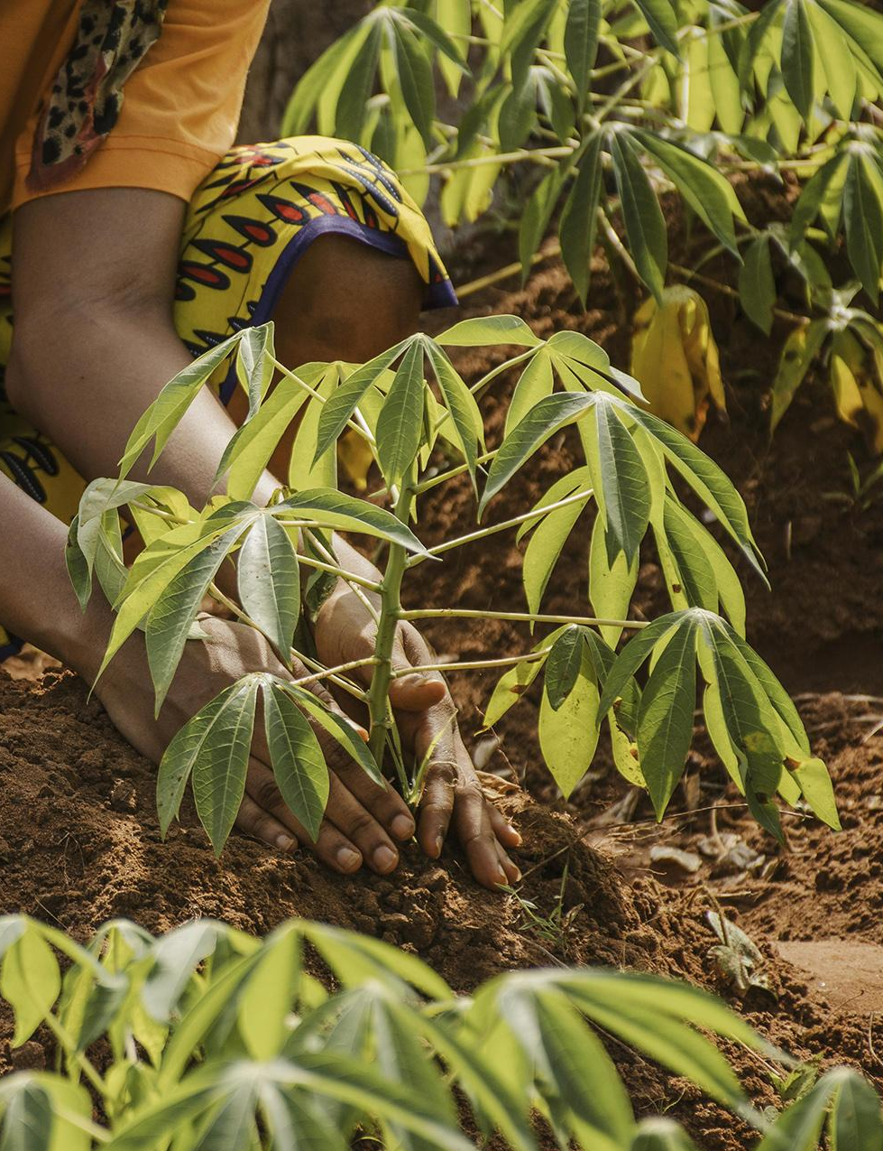
AgrowCulture
Farm, Invest, Grow!!
Members:
Mohammad Ittehad Rahman Sami 200042131
Maliha Zaman 200042114
Nazia Karim Khan Oishee 200042137

Slide 2
Introduction
➢AgrowCulture is a web platform where we bring the people working hard in the agricultural sector in direct contact with the investors and buyers to aid them grow.
➢AgrowCulture is going to be the solution of the traditional supply chain which is highly inefficient, unorganized and has a high rate of food wastage.
➢AgrowCulture also enables Bangladesh agriculture financing as it offers an investment opportunity with attractive long term and short term investments.
1

Slide 3
Key Features
01
02
Funding
Investment
03
04
Selling
Purchase
2

Slide 4
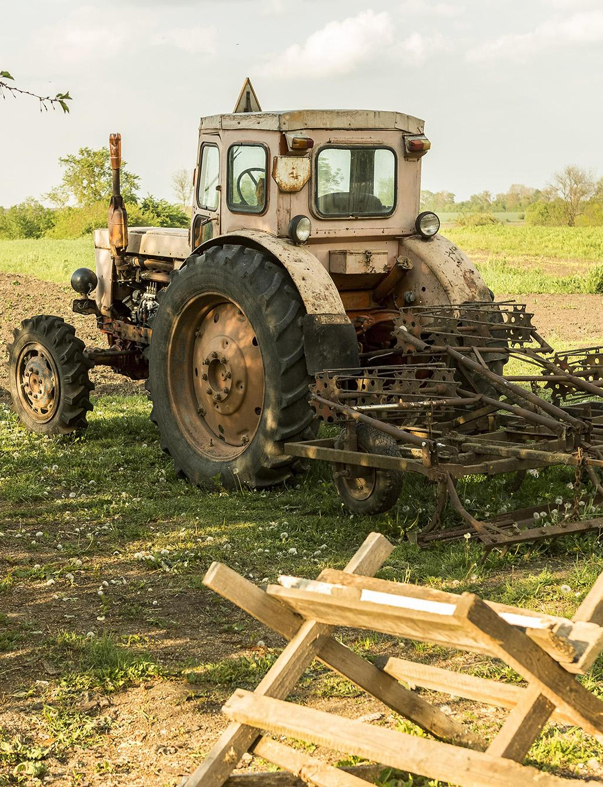
Funding
People working in the agricultural sector looking for financial help will be able to submit their plea.
3

Slide 5
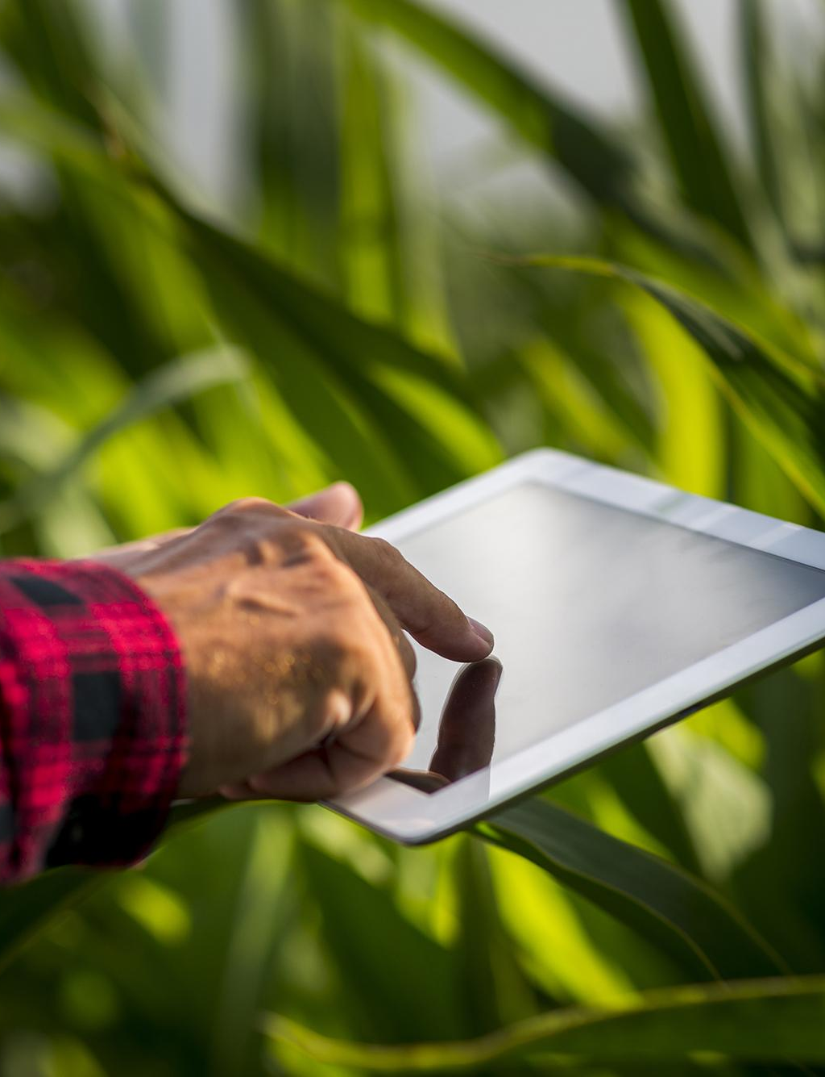
Investment
People can get into the world of investing by making investments through our website.
4

Slide 6
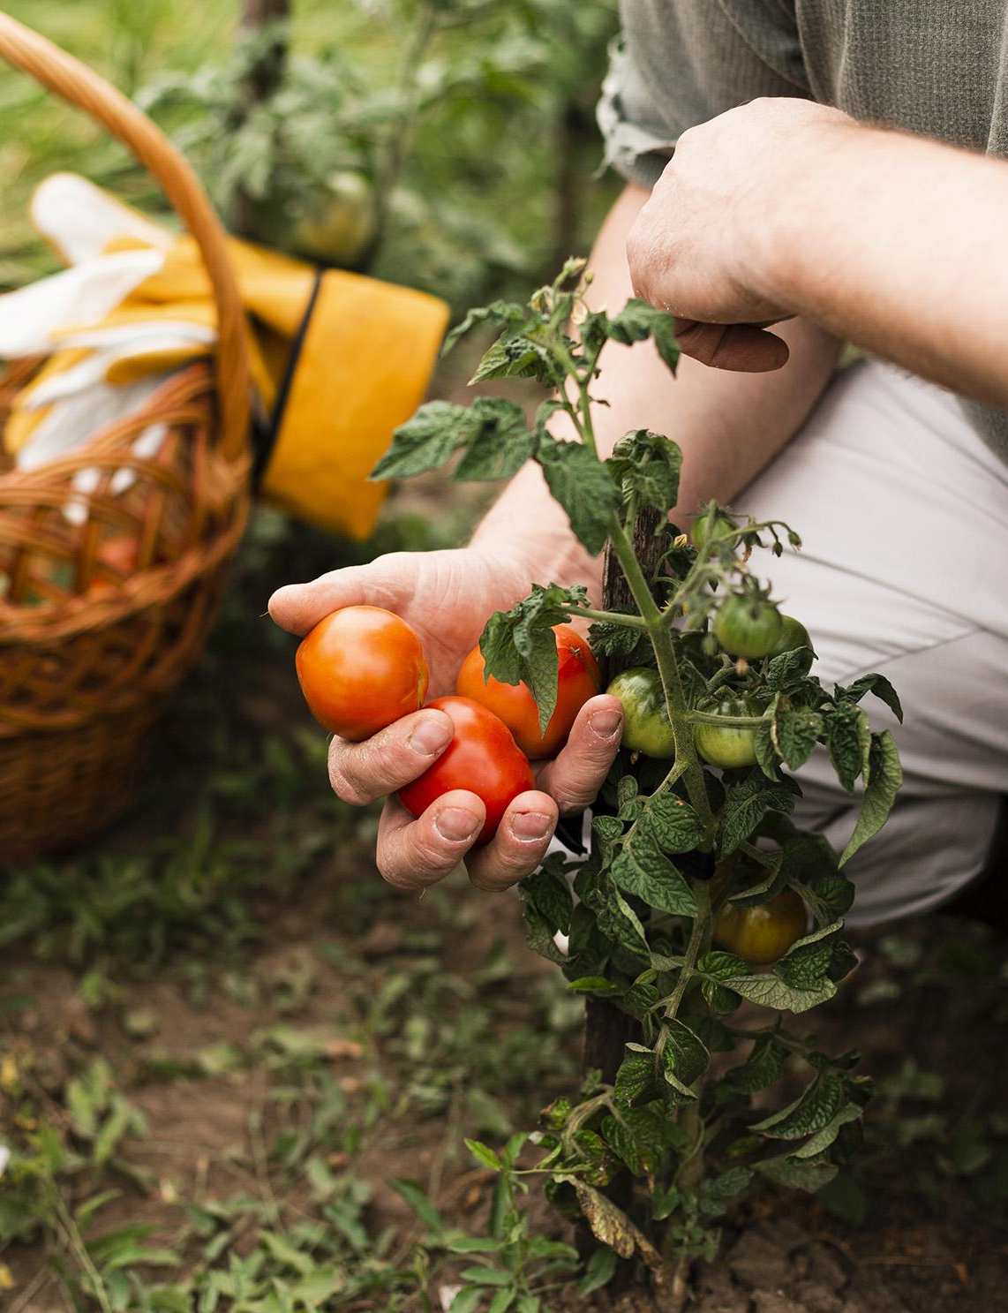
Selling
People can sell their products directly through our website.
5

Slide 7
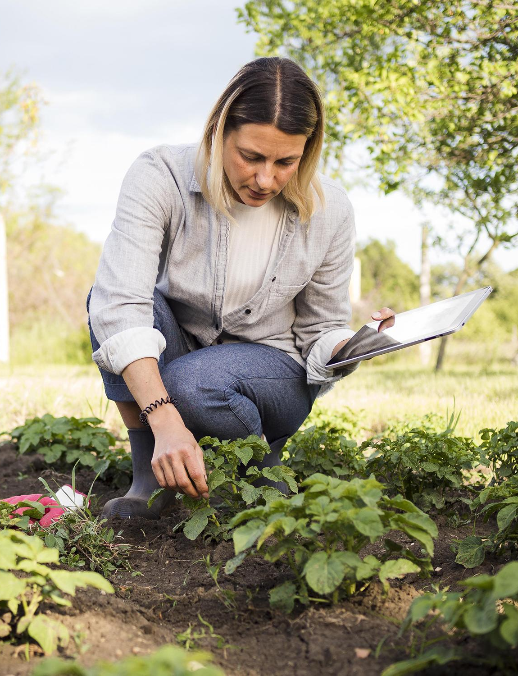
Purchase
Buyers will be able to buy products through our website like other e-commerce platforms.
6

Slide 8
Implementation:
After Progress Presentation
Till Progress Presentation
User profile, authentication, account verification, dashboard, one core feature: Funding
Other core features: Investment, Selling and Purchase.
Additional features: Review
7

Slide 9
Contribution made by team members
Features | Contribution
Website layout | Frontend done by Maliha Zaman
Authentication | Frontend done by Maliha Zaman, Backend by Nazia Karim Khan
Verification | Both frontend and backend done by Ittehad Rahman Sami
Password Recovery | Both frontend and backend done by Ittehad Rahman Sami
User Profile | Frontend done by Maliha Zaman, Backend by Nazia Karim Khan
Funding & Investment | Frontend done by Maliha Zaman, Backend by Nazia Karim Khan
Selling & Purchase | Frontend done by Maliha Zaman, Backend done by Ittehad Rahman Sami
Review | Frontend done by Maliha Zaman, Backend done by Nazia Karim Khan
8

Slide 10
Entity Relationship Diagram
9

Slide 11
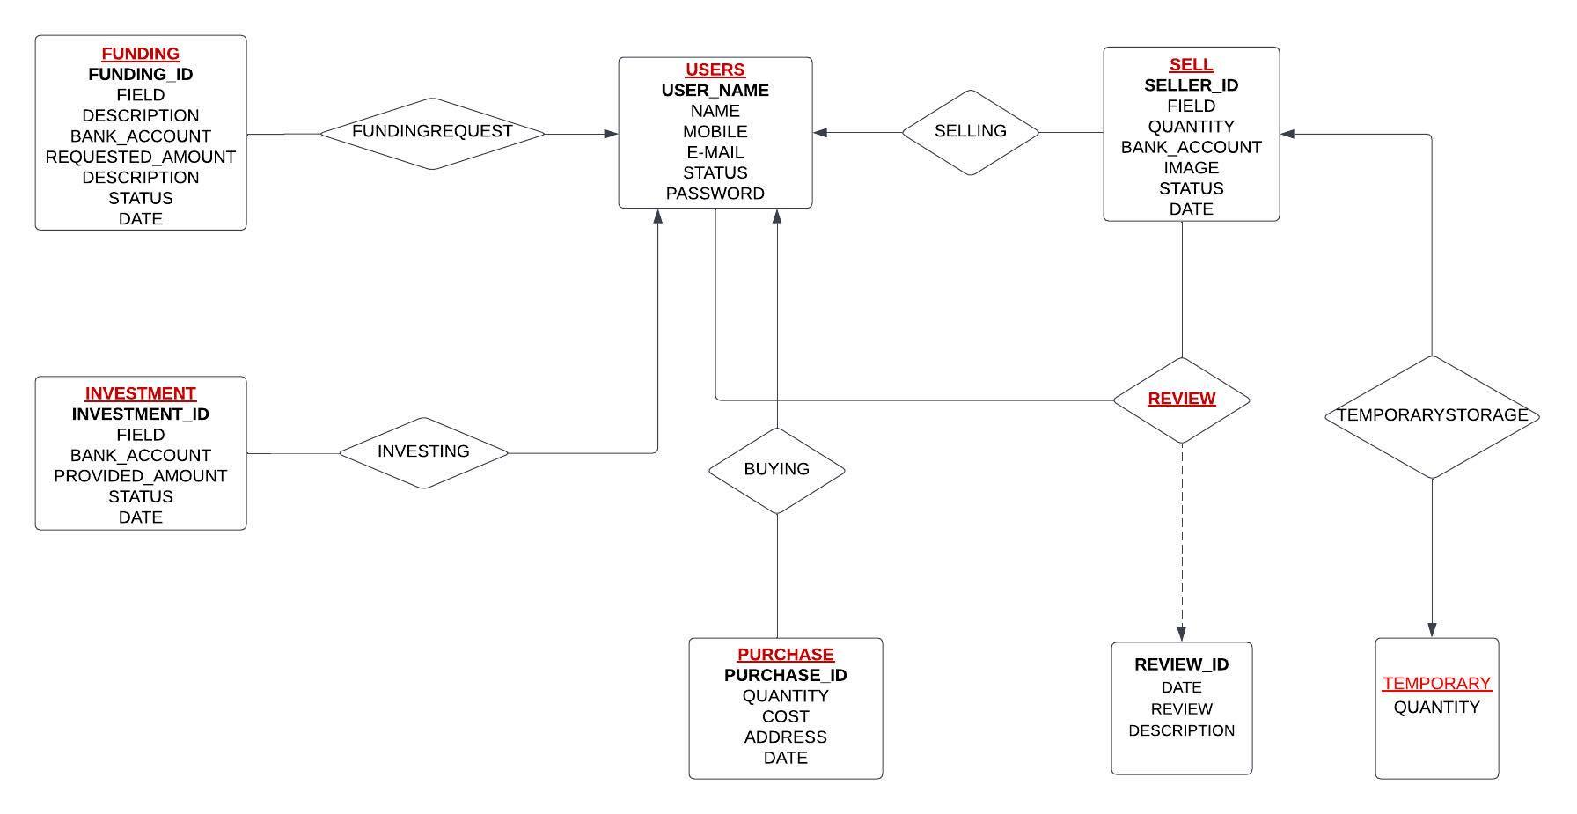
10

Slide 12
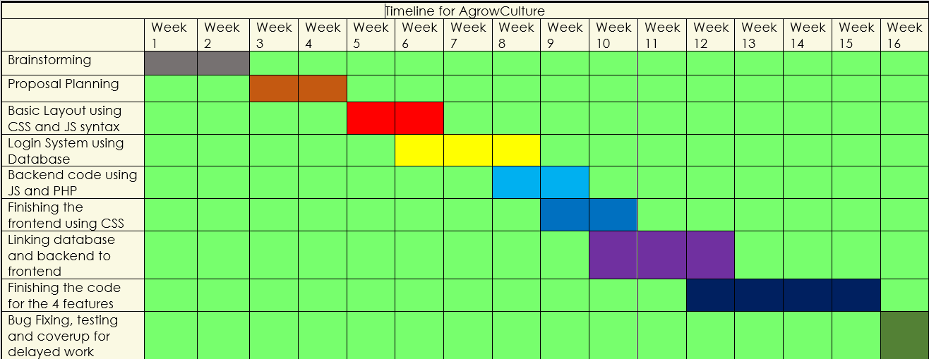
AgrowCulture Timeline
11

Slide 13
Demonstration of AgrowCulture
12

Slide 14
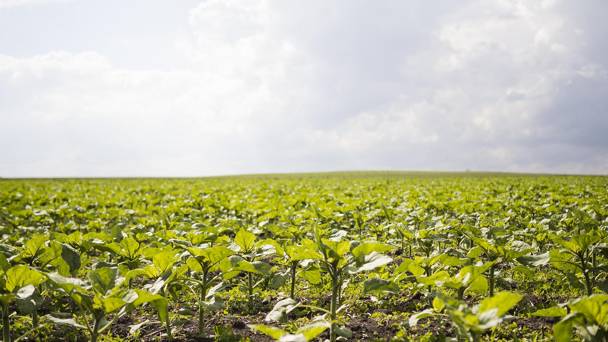
Thank You

